Slide 1
ABC Car Cleaning
Where to open new locations in new York
David Samet

Slide 2
The Problem
Company Name
ABC Car Cleaning
Location
New York State
Problem
Where to open new locations

Slide 3
data explanation
Data set #1
Data set #2
A data set of all current Car Wash locations in New York
The first data set is from the US Census bureau,
This data set has all the counties of the US
And then I extract all New York counties from them
This Data set was generated via the Foursquare API

Slide 4
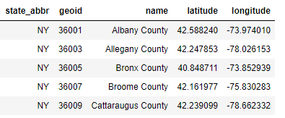
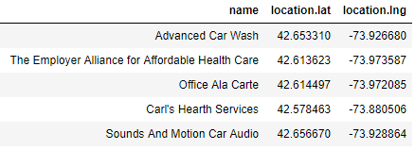
Data sets used
This is an example of the NY counties Data Set
This is an example of the Foursqure Data Set

Slide 5
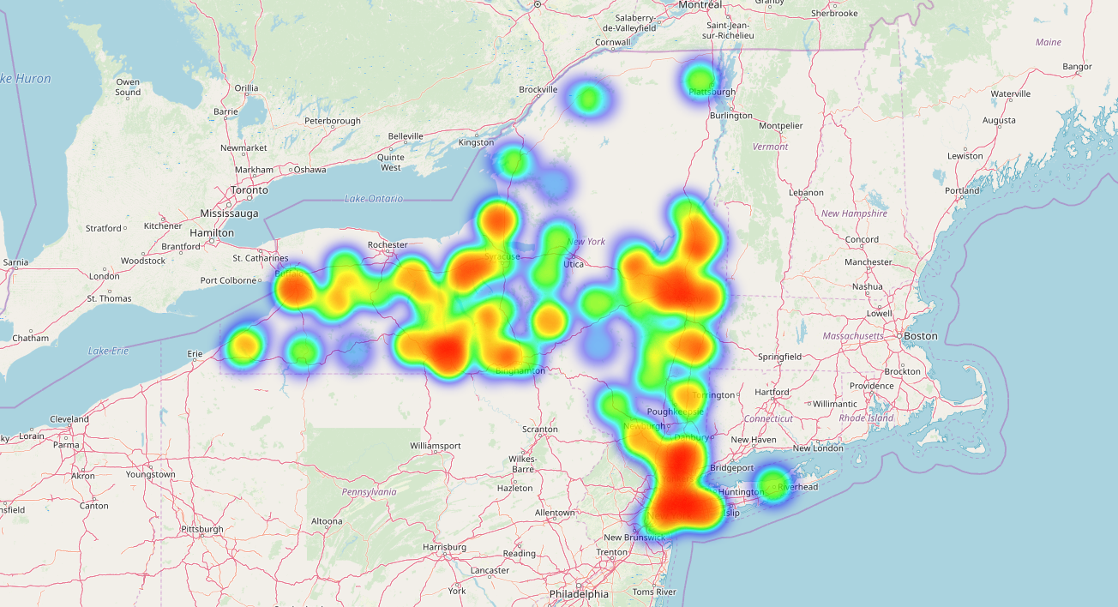
Results in the whole new York
There is no any Car Washes in Upstate New York

Slide 6
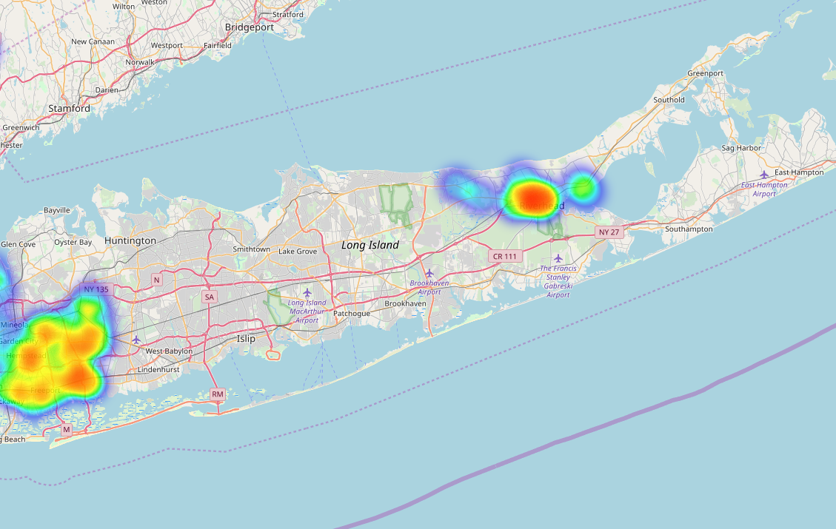
Results in Long island
In Long Island
there is definitely place for more Car Washes

Slide 7
Final Result
After viewing the heat map, we can clearly see that in Long Island there is a nice part of where there is no Car Wash,
as well as more in Upstate NY above Lake George there is also not a lot of Car Washes
However, it will be worth to do an extra layer of analysis and get the vehicle registration data from the New York DMV to compare the number of cars per area with the amount of Car Washes

